Slide 1
Customer Retention Presentation
By Nishant Pokhriyal

Slide 2
Problem Statement
This dataset shows the factors on which the usage of Retailer Websites depends, there are different columns showing that what people want from an online retailer and from which they are getting them.
In this dataset our main focus will be to analyze the factors affecting the retention of the customers and on the basis of that we have to identify which of the following websites or the application is best suited to the people and they want to recommend others.

Slide 3
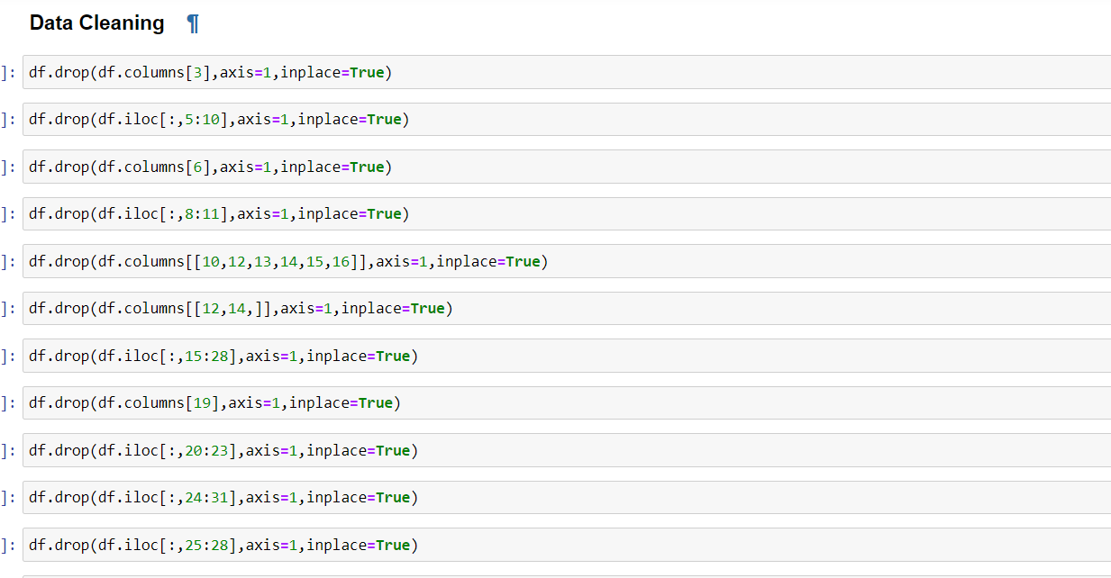
EDA Steps and Visualizations

Slide 4
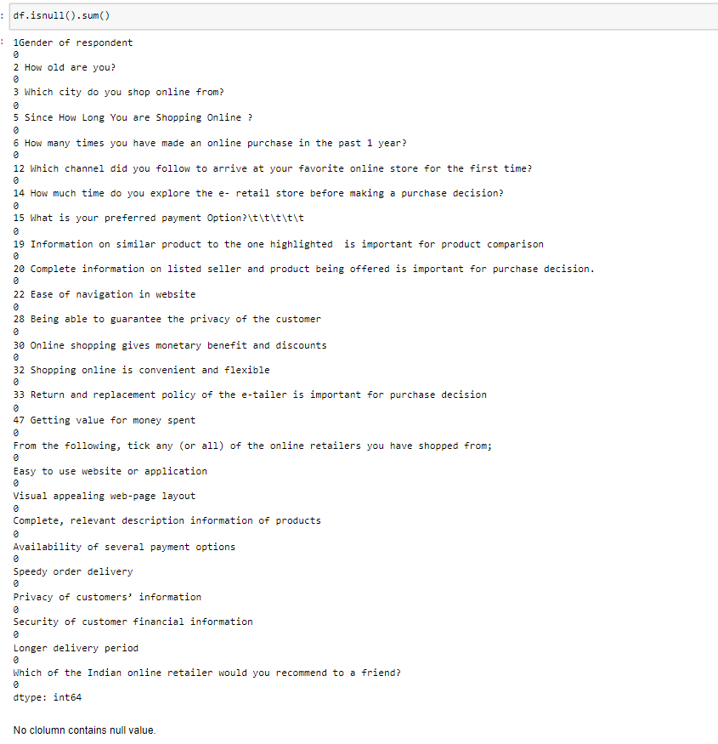

Slide 5
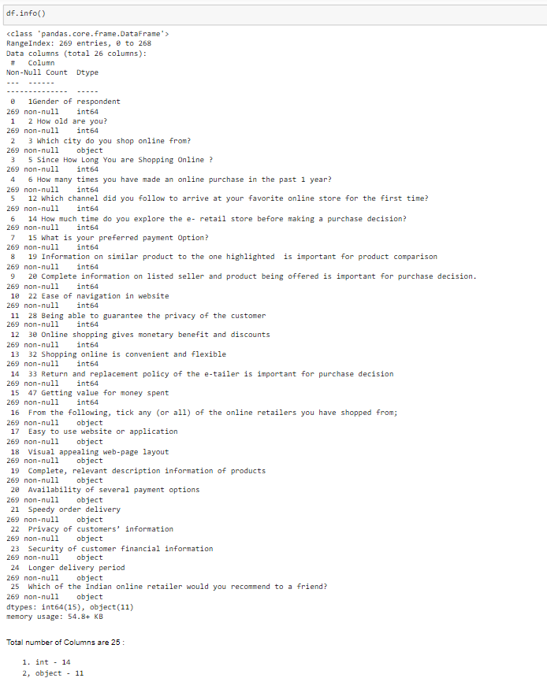

Slide 6
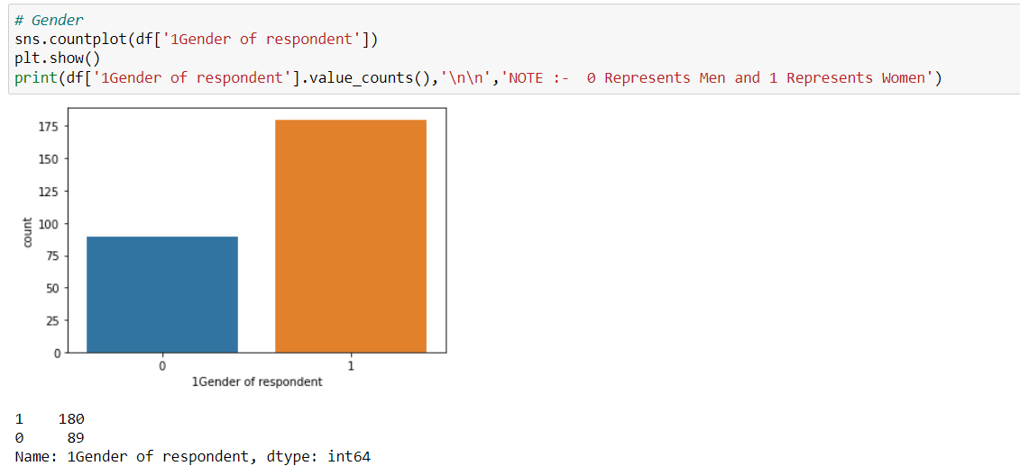

Slide 7
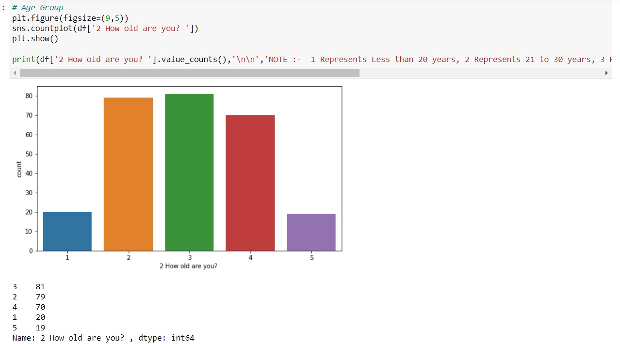

Slide 8
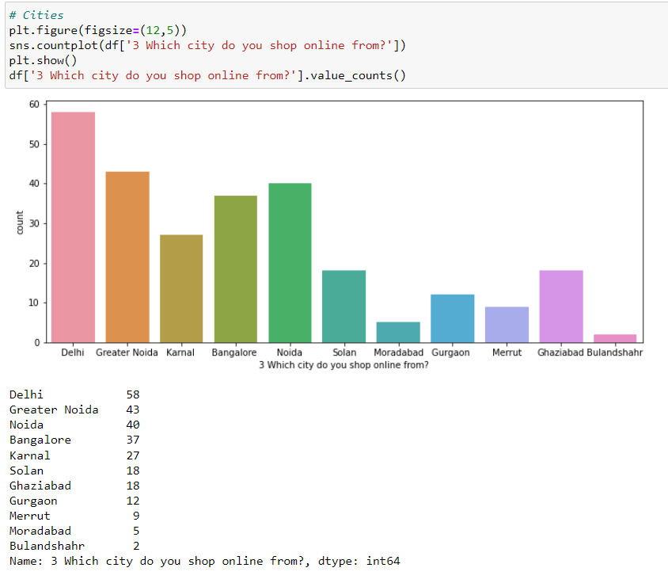

Slide 9
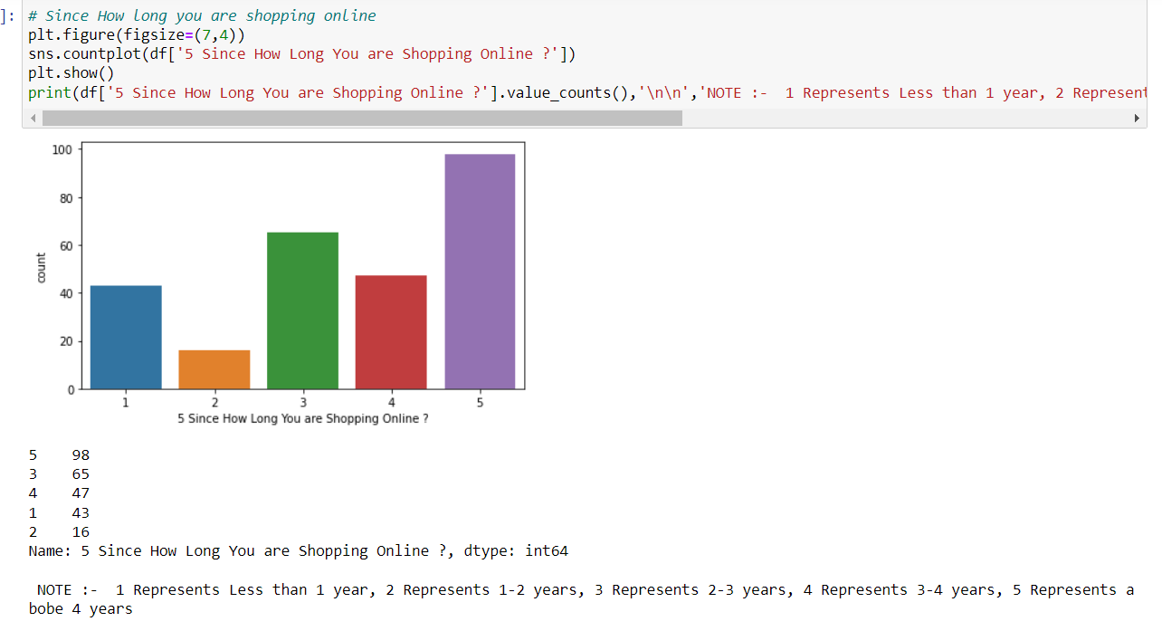

Slide 10
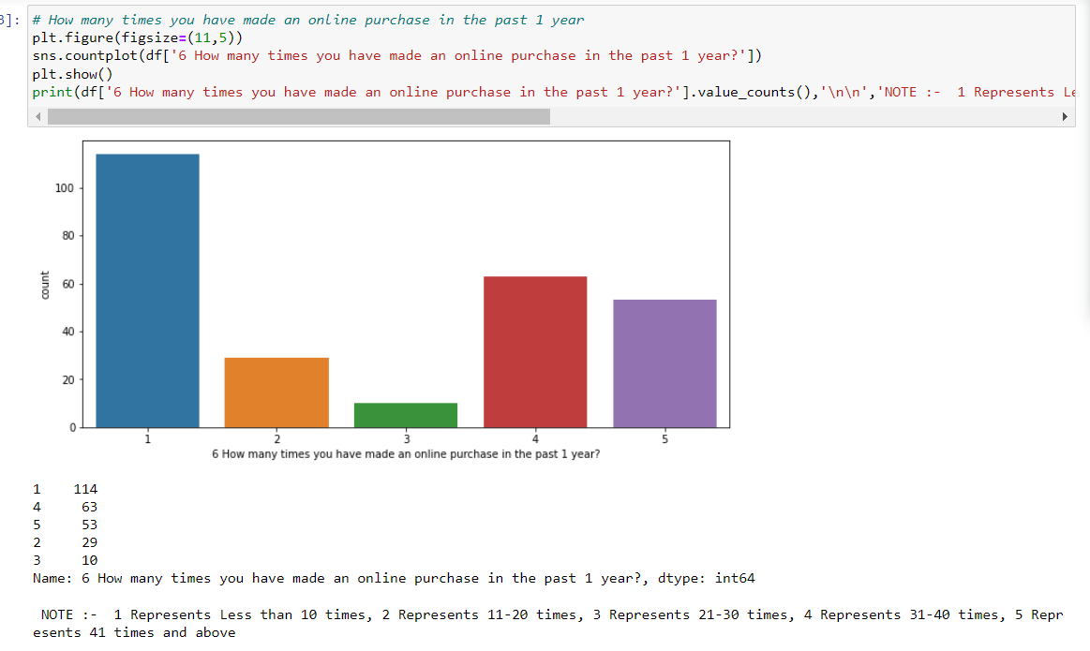

Slide 11
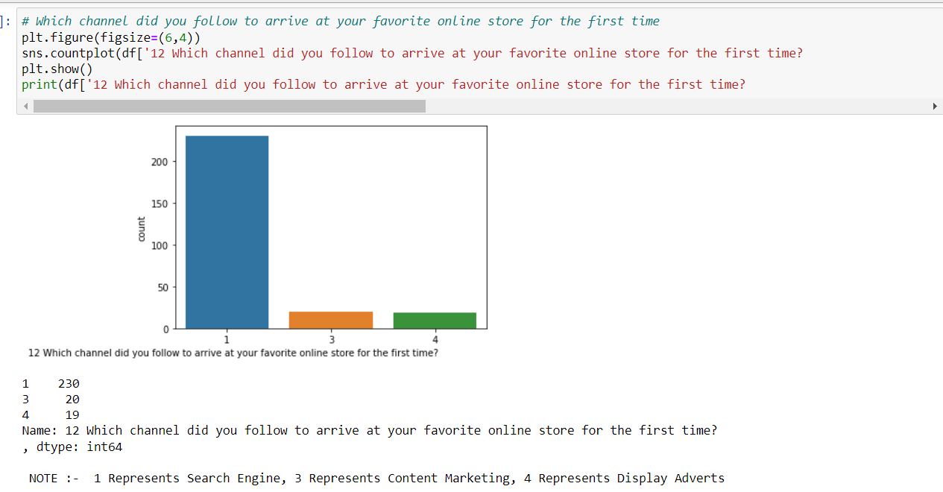

Slide 12
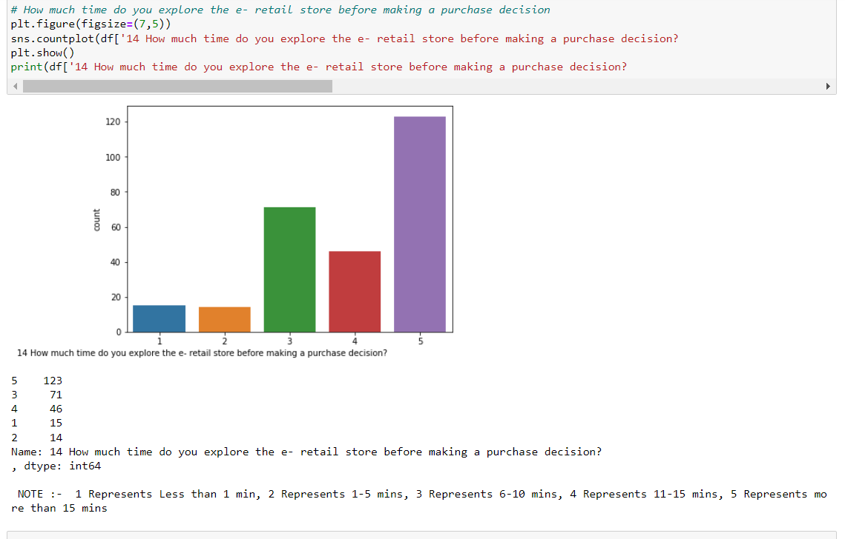

Slide 13
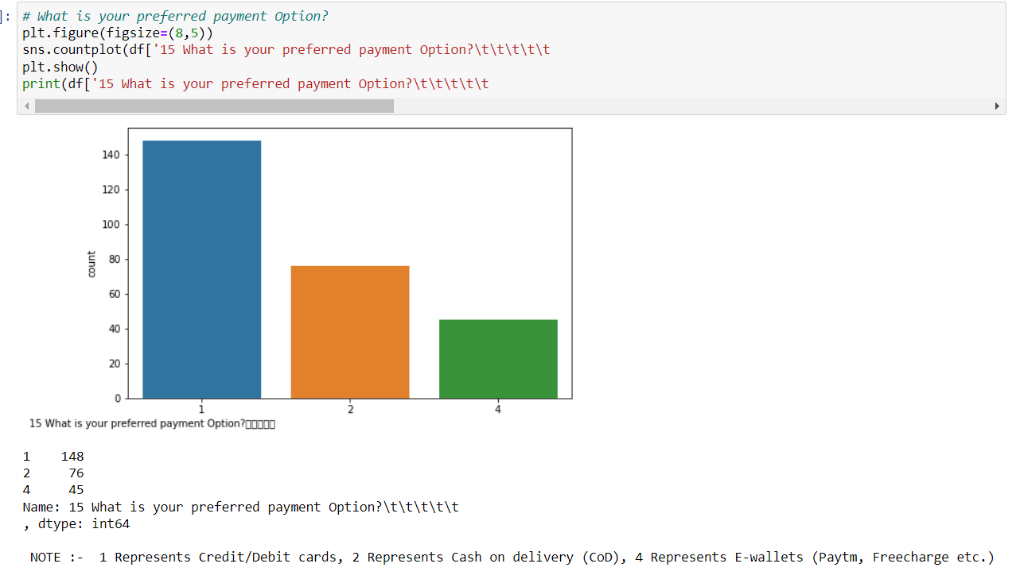

Slide 14
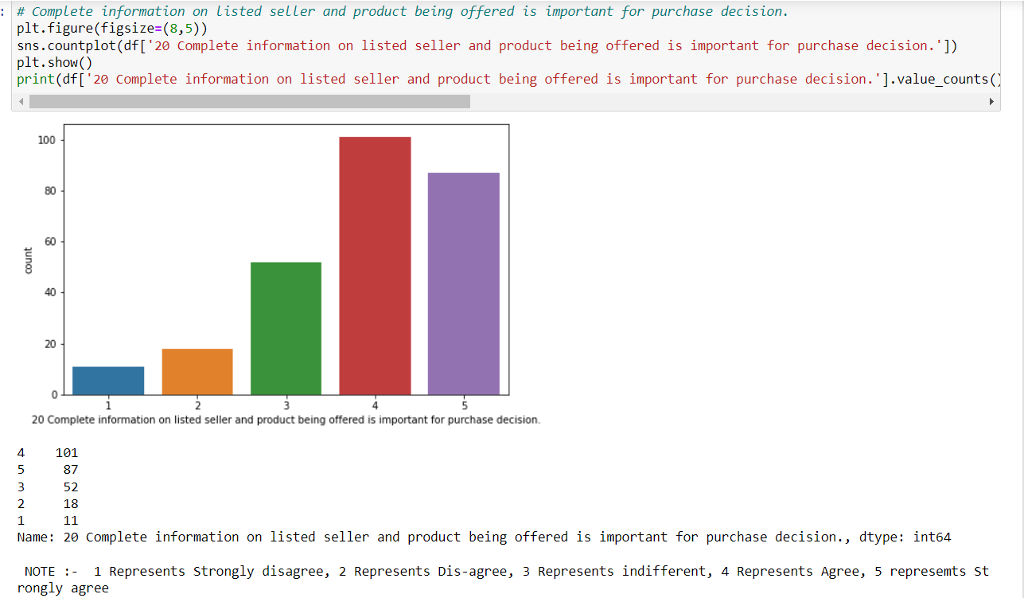

Slide 15
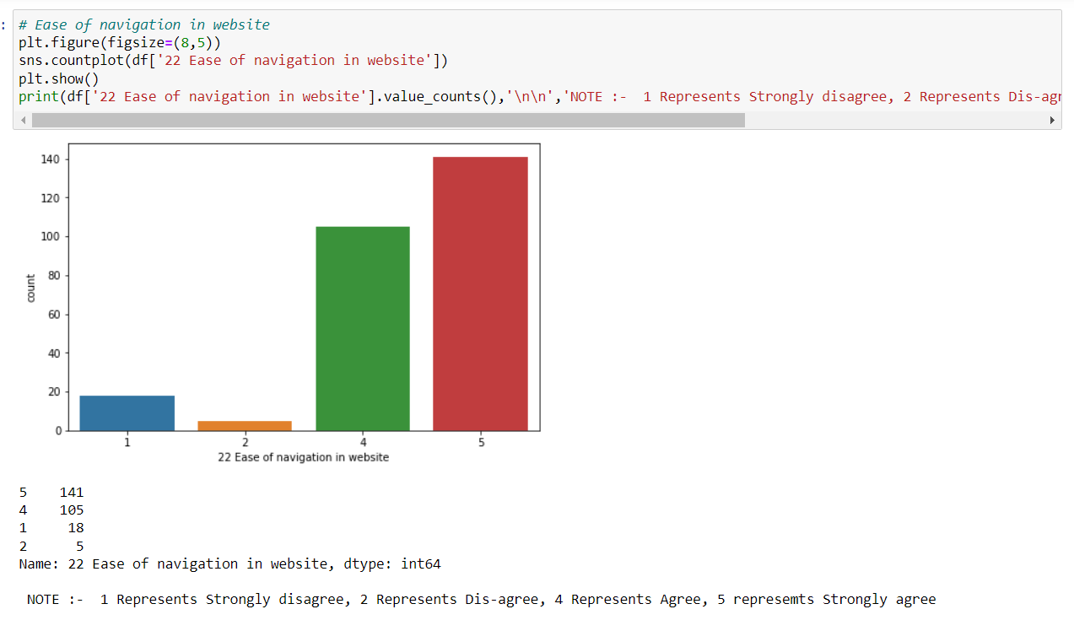

Slide 16
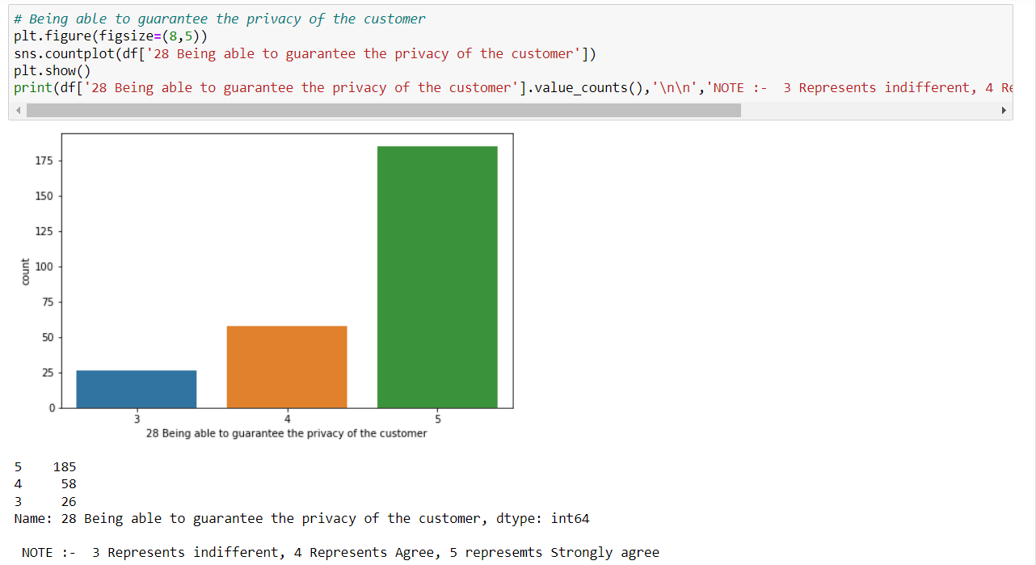

Slide 17
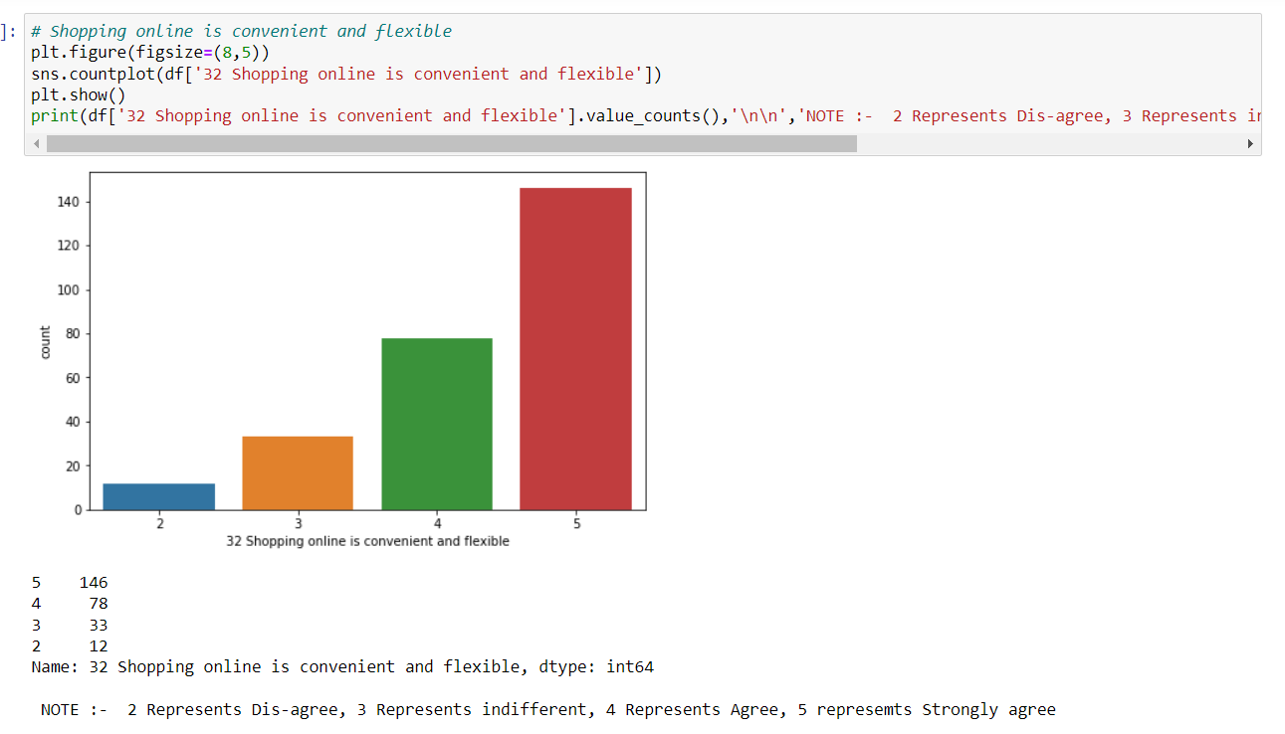

Slide 18
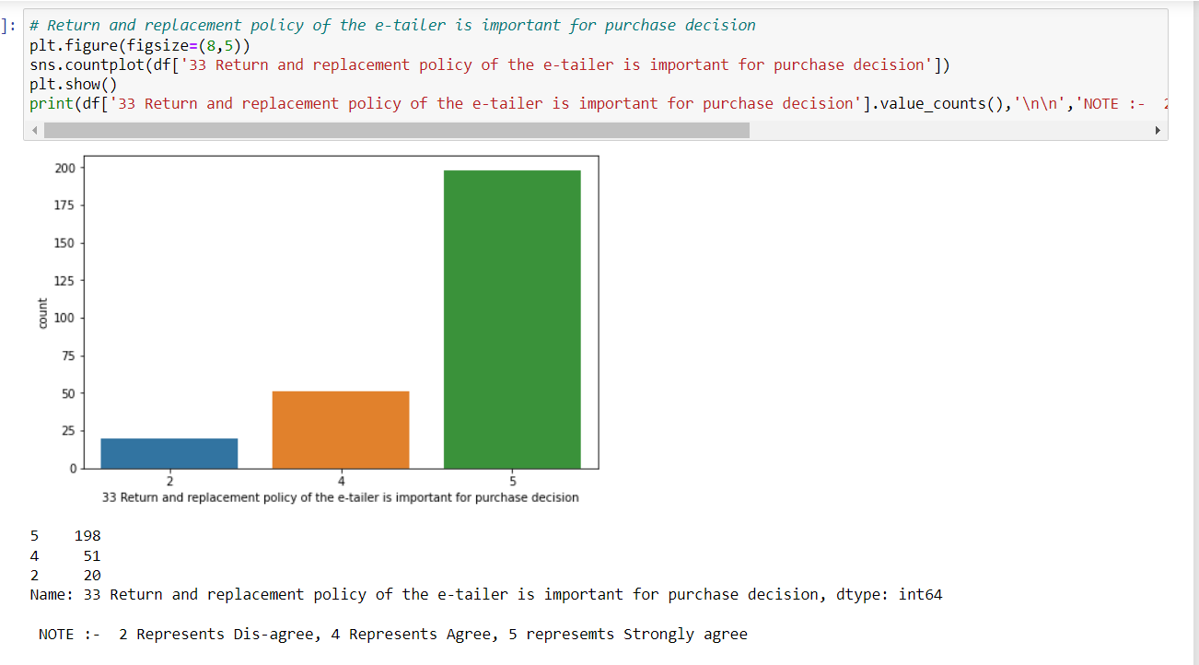

Slide 19
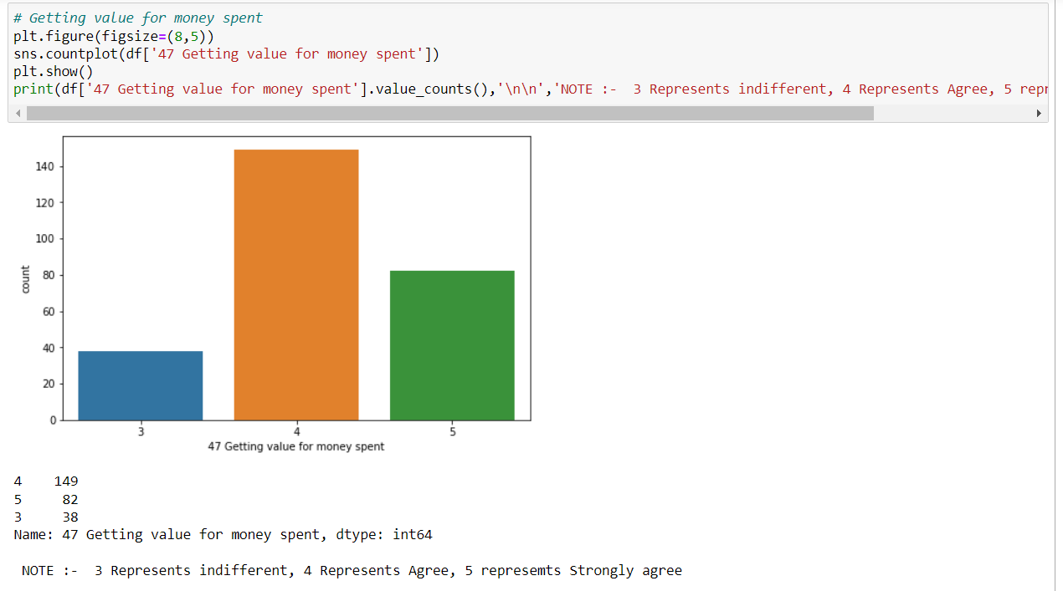

Slide 20
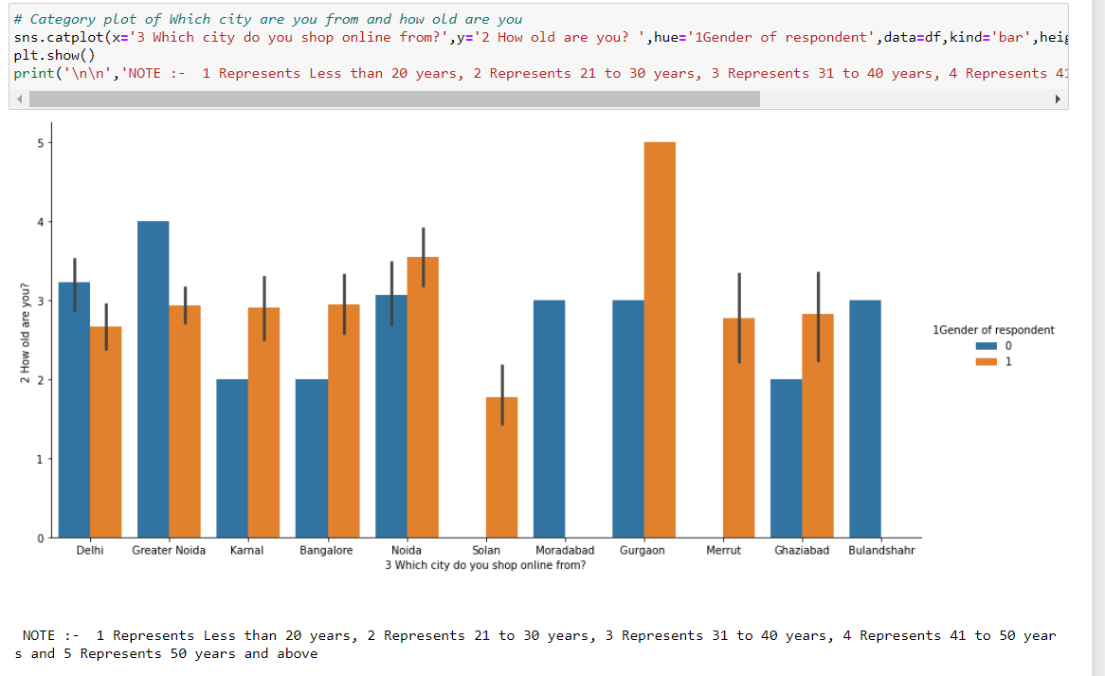

Slide 21
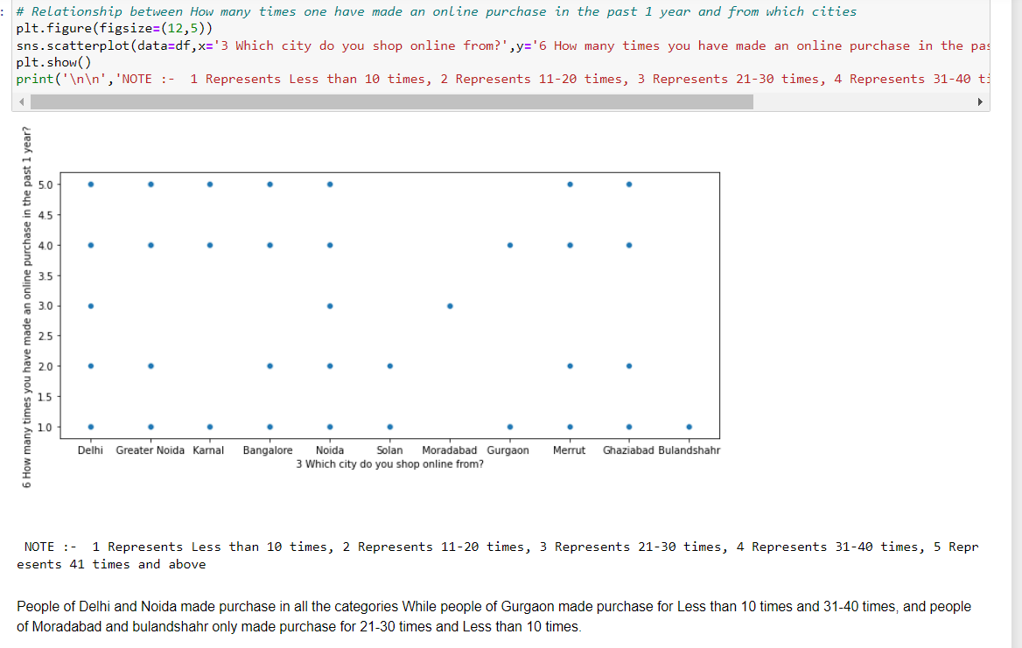

Slide 22
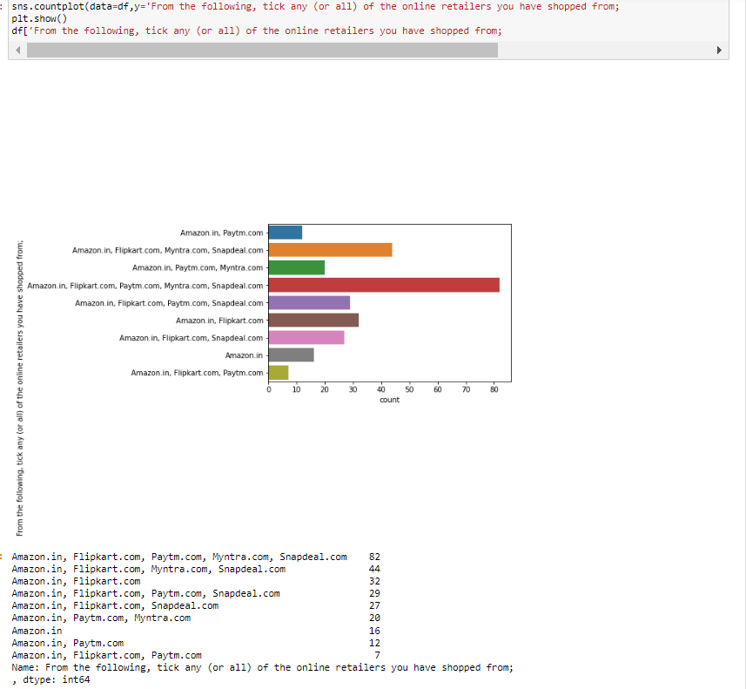

Slide 23
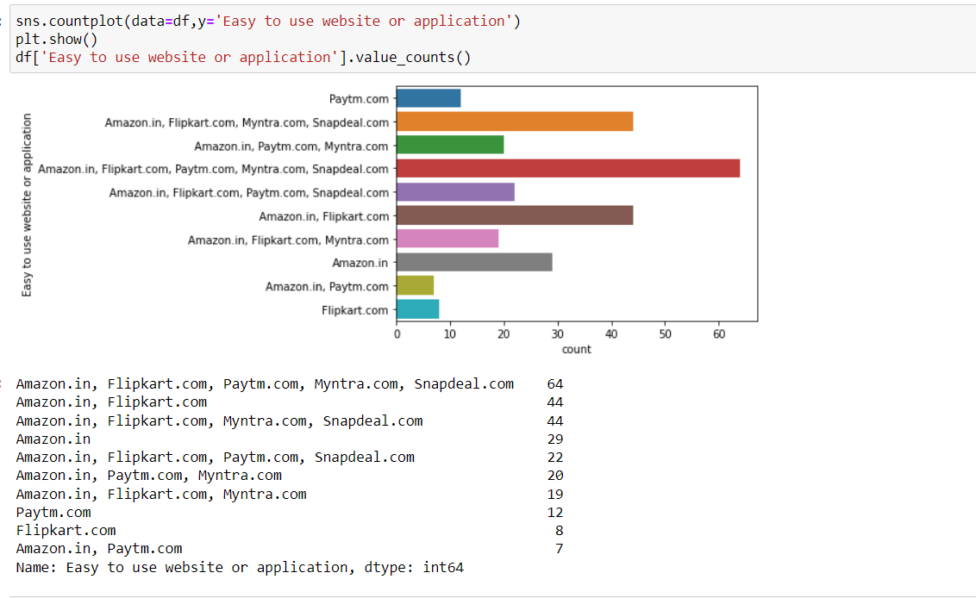

Slide 24
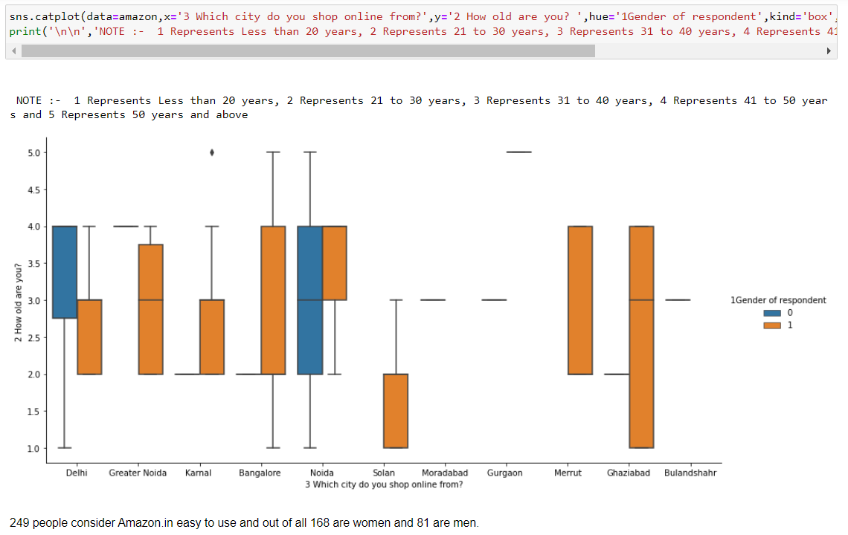

Slide 25
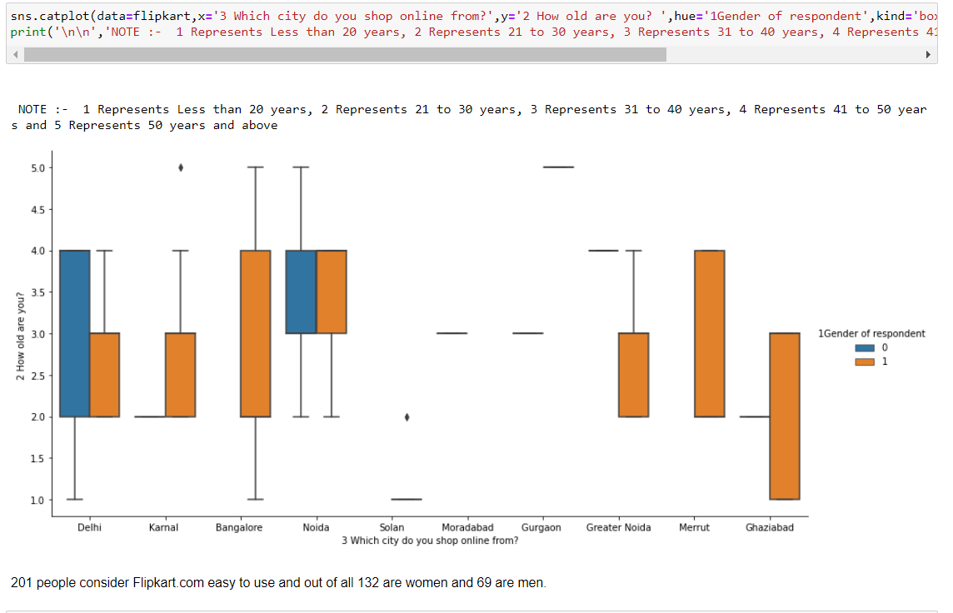

Slide 26
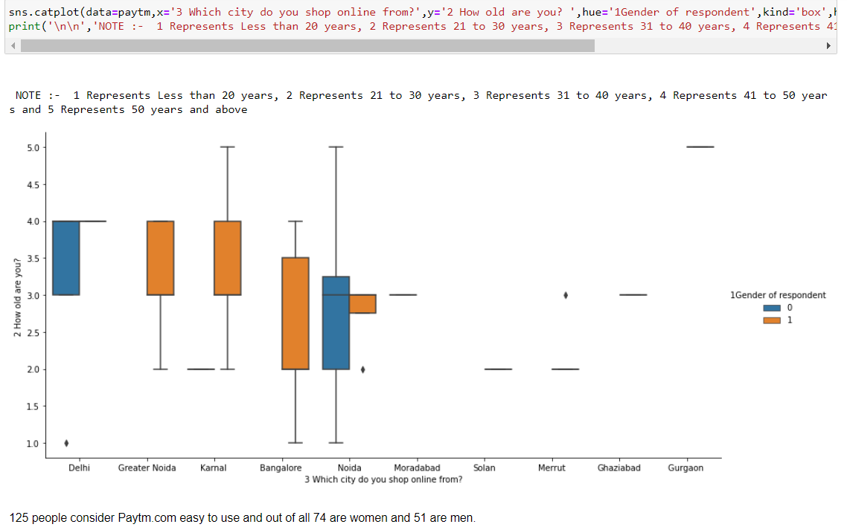

Slide 27
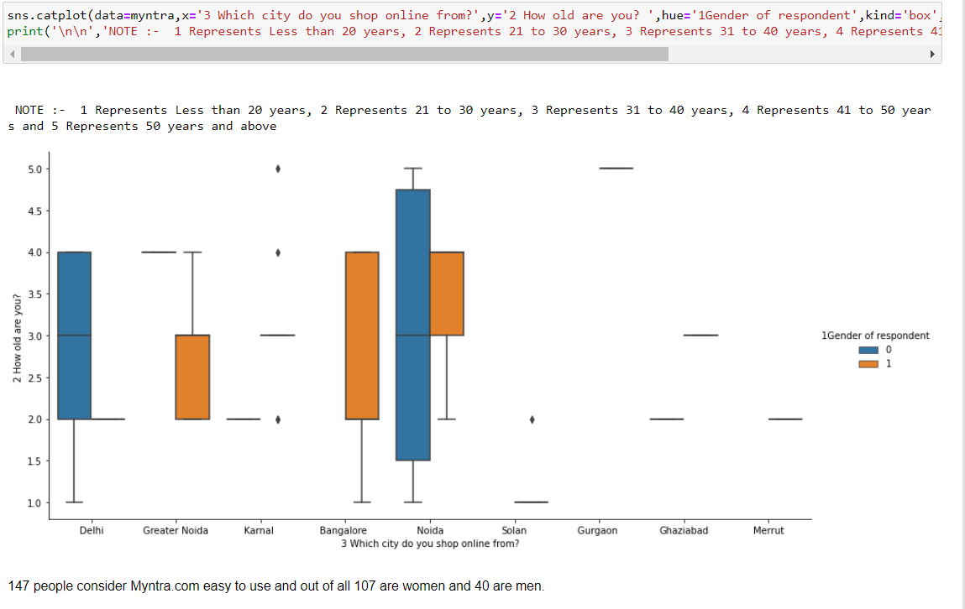

Slide 28
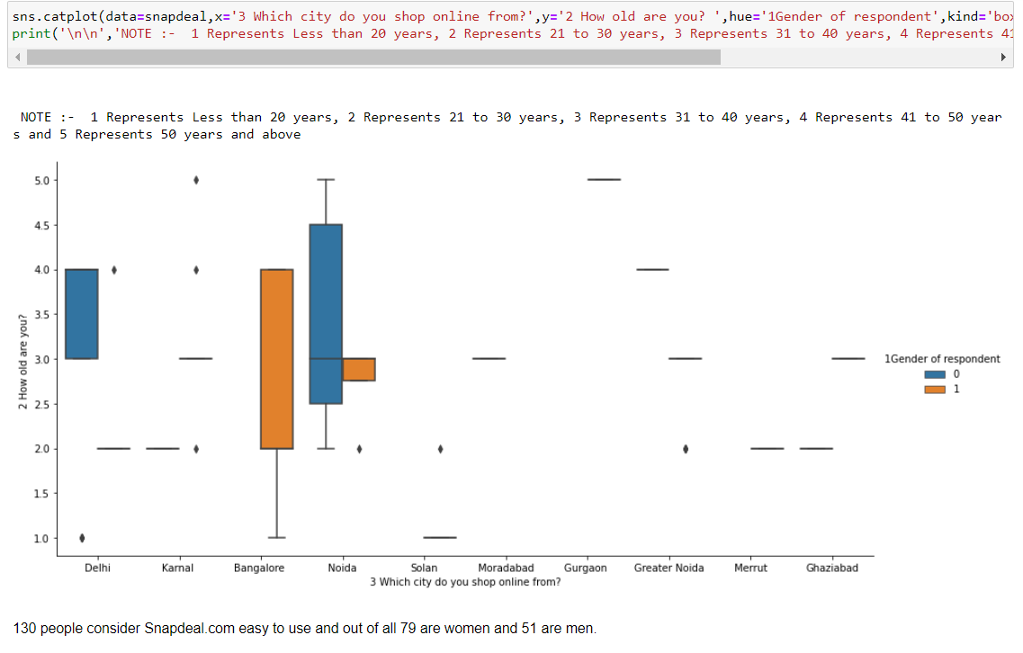

Slide 29
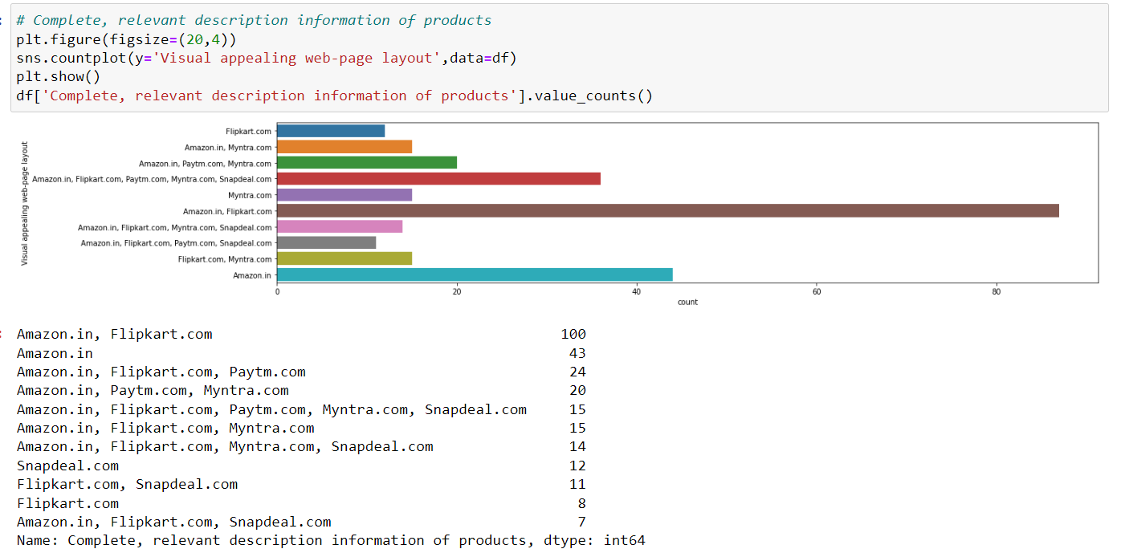

Slide 30
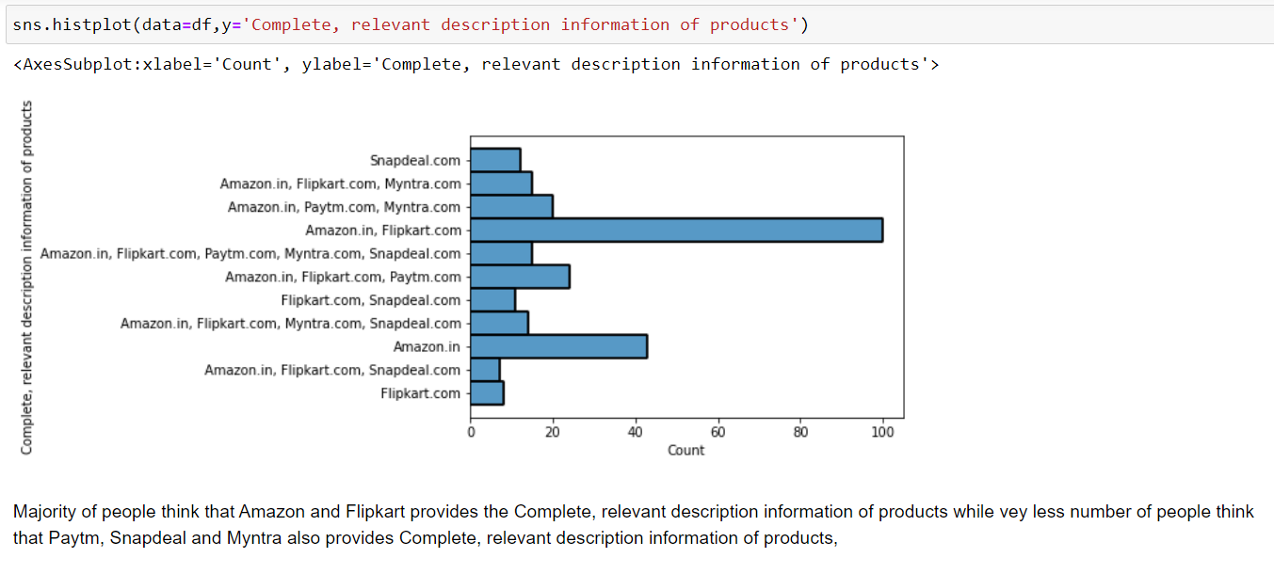

Slide 31
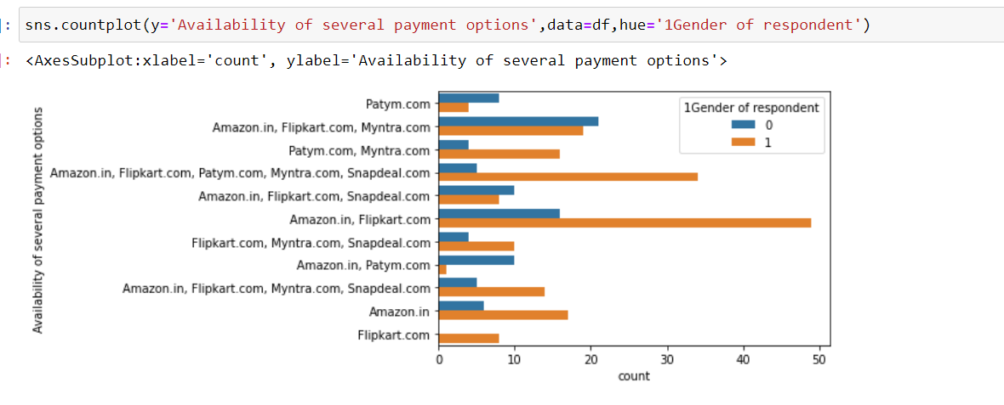

Slide 32
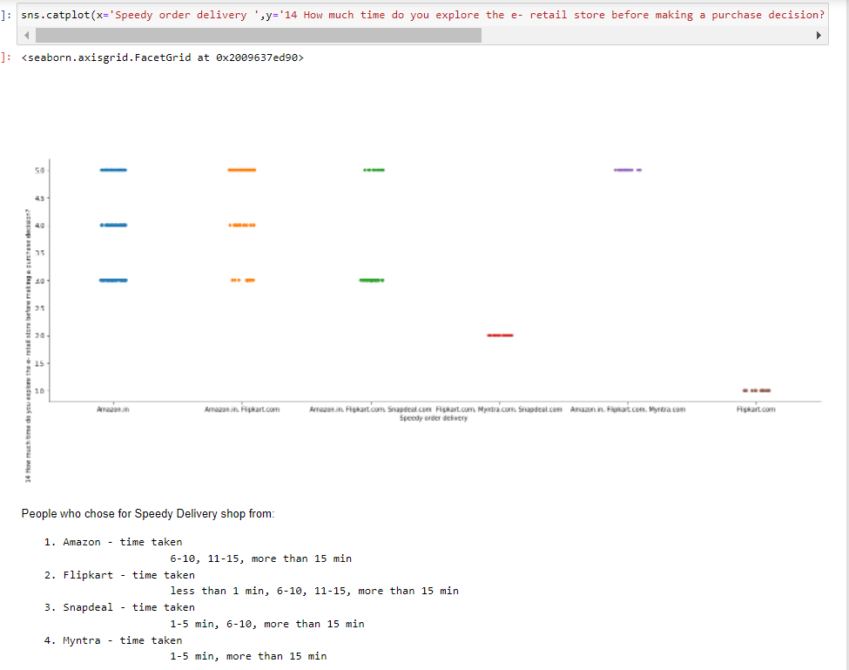

Slide 33
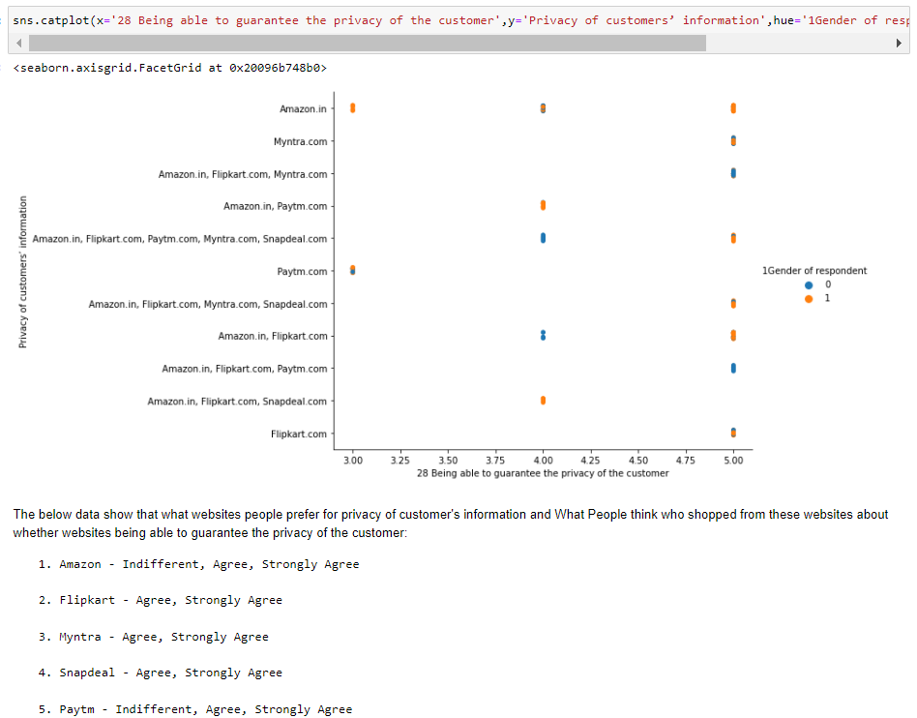

Slide 34
Conclusion
We were analyzing this dataset to check which of the websites or application is the most trusted and preferred by people. We chose different libraries for creating the data frame and making graphical representations of the data. By counting and plotting the data from the columns we observed that Amazon and Flipkart are the most used and recommended websites while Paytm and Snapdeal were the least recommended websites.

